Slide 1
Spring 2024 SQL/ETL
5-16-2024
CanCode Communities

Slide 2

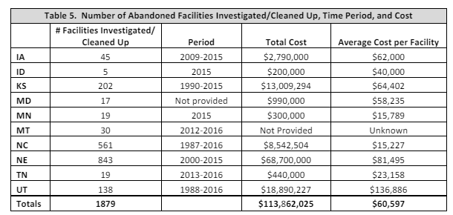
Introduction to Jonny B
Assigned to GE’s Program Management
Completed Fall 2023 SQL / ETL class
Used SQL Server Management Studio
Talend Open Studio
Video game social media company
Objectives:
Get to know you
General tips (PMI)
Information about middleware at GE
SQL experiences and general information
Abandoned Underground Storage Tank (UST) Systems Report," Association of State and Territorial Solid Waste Management Officials (ASTSWMO), December 2017. Available at: ASTSWMO Report.

Slide 3
One-Minute Career Challenges
Share a moment in your career (or job search) that you had to overcome a challenge.
Who are you?
What did you learn from the experience?
How did you overcome adversity?

Slide 4
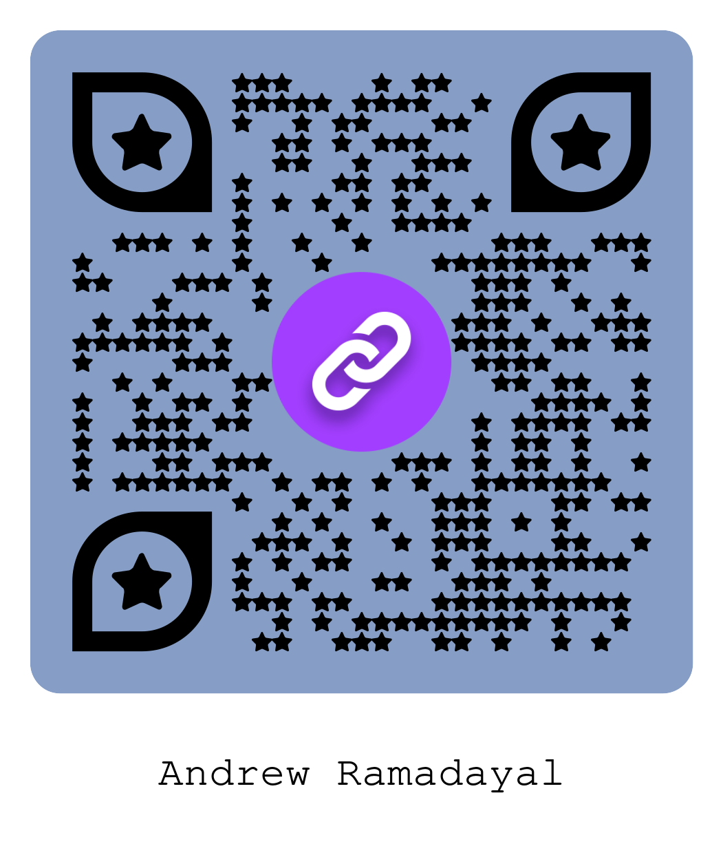
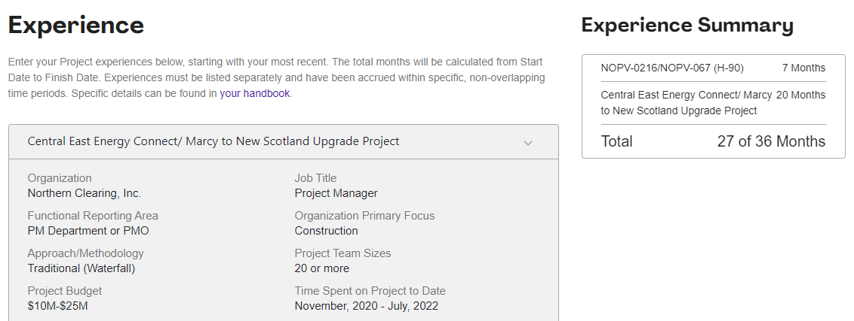
Project and Product Management
Project Management Institute (PMI)
www.pmi.org
PMP, CAPM, PMI-ACP, PMI-CP
3-4 hour exams
PDUs & three professional references

Slide 5
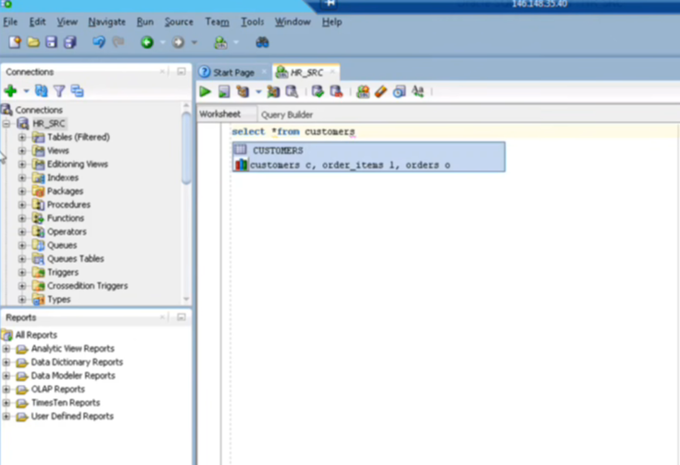
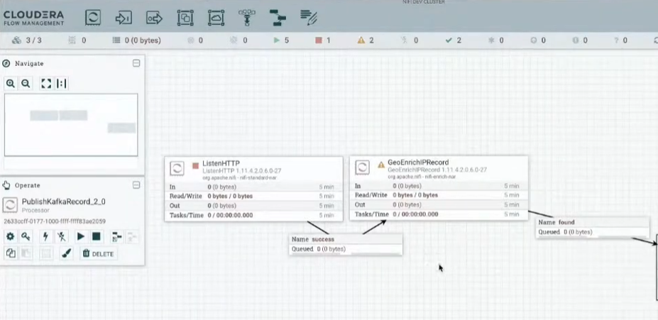
Some App Information, Possibly Re: GE
GOLDNet (for legal entity changes)
EBAM (Electronic Bank Account Management)
ThreadConnect (Apache NiFi with a makeover)
Quantum (processes and archives, Transport Management)
Globalscape (archiving and FTP)
FX Rates / Atlas FX (Foreign Exchange)
Informatica (processes people data with encryption)
Apigee
Informatica
May / may not be just like TC

Slide 6
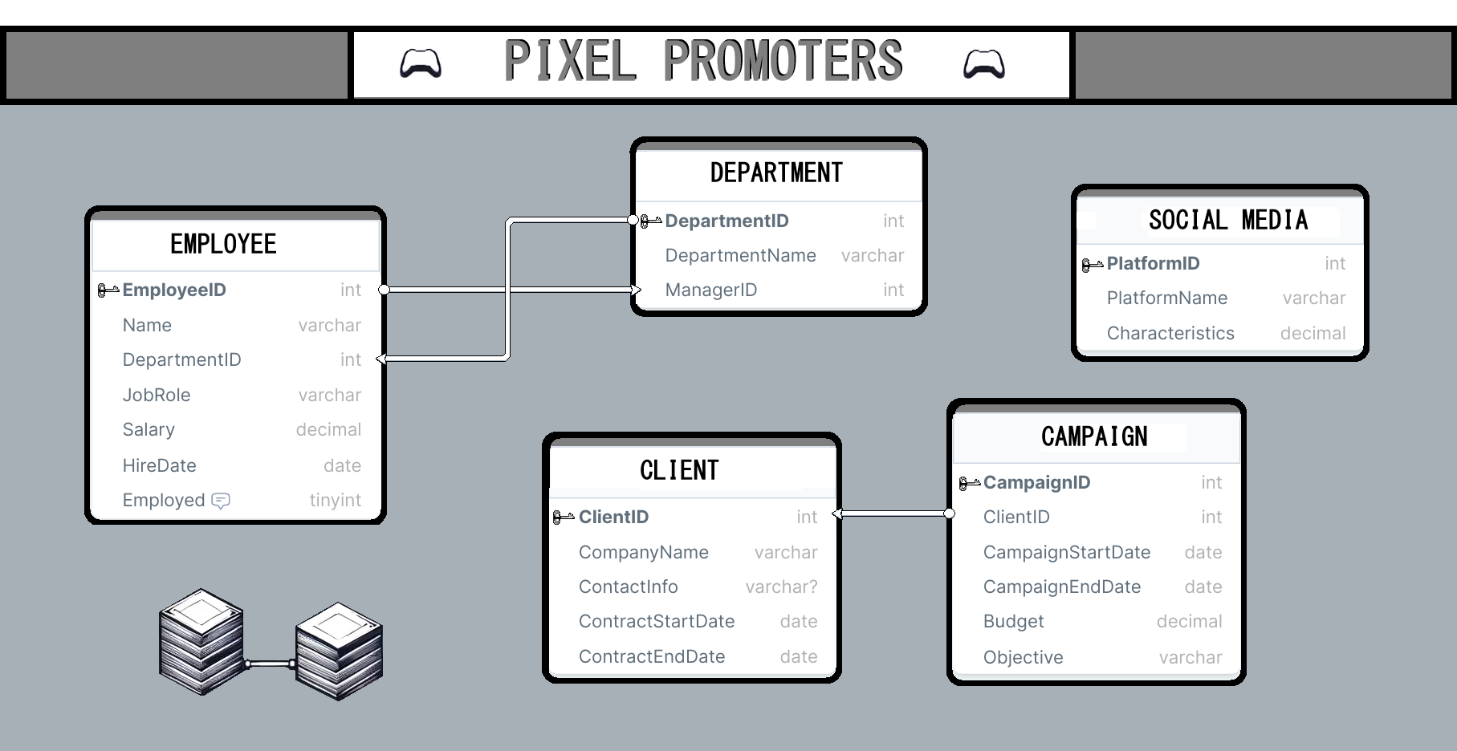

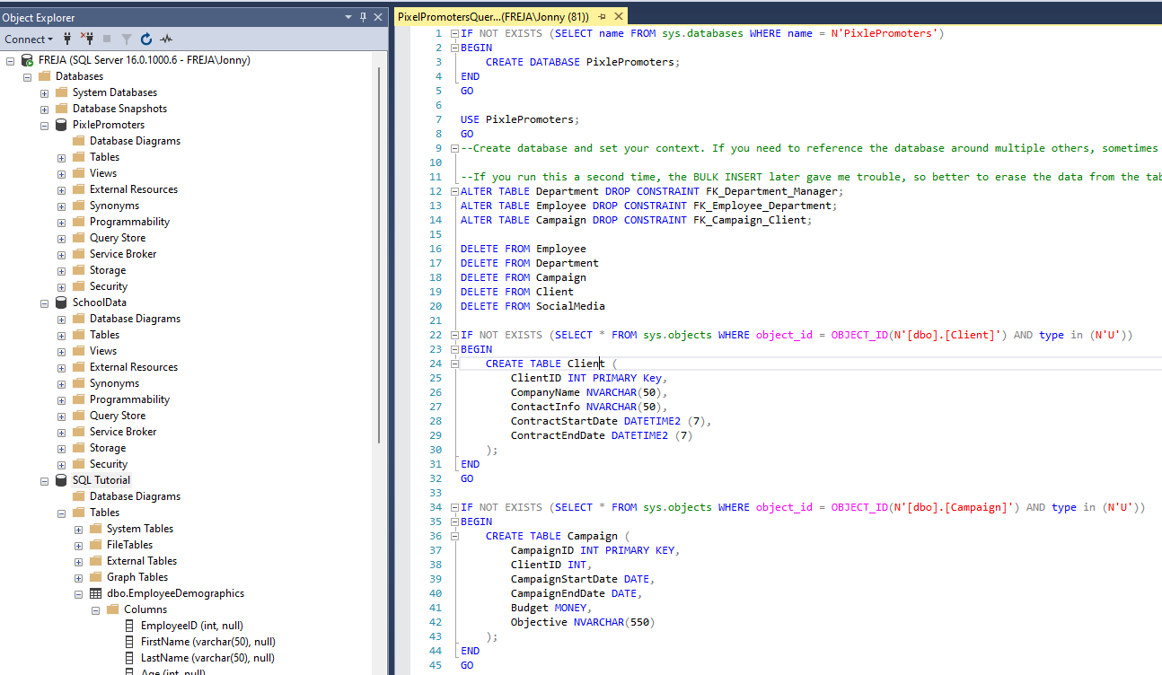
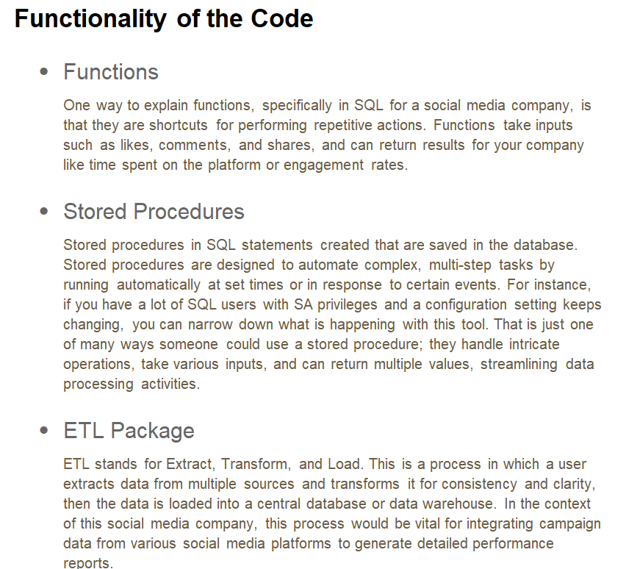
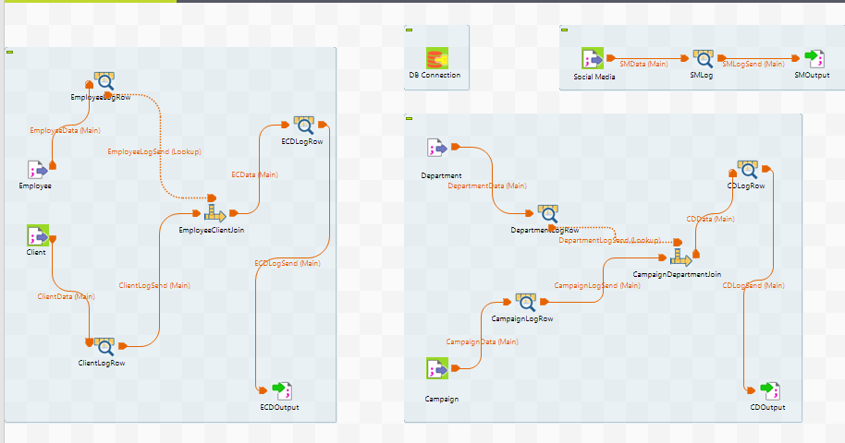
Final SQL Project
Diagram
Tables, primary and foreign keys
Write up
Love letter to a customer
SQL/ ETL Project
The meat and potatoes

Slide 7
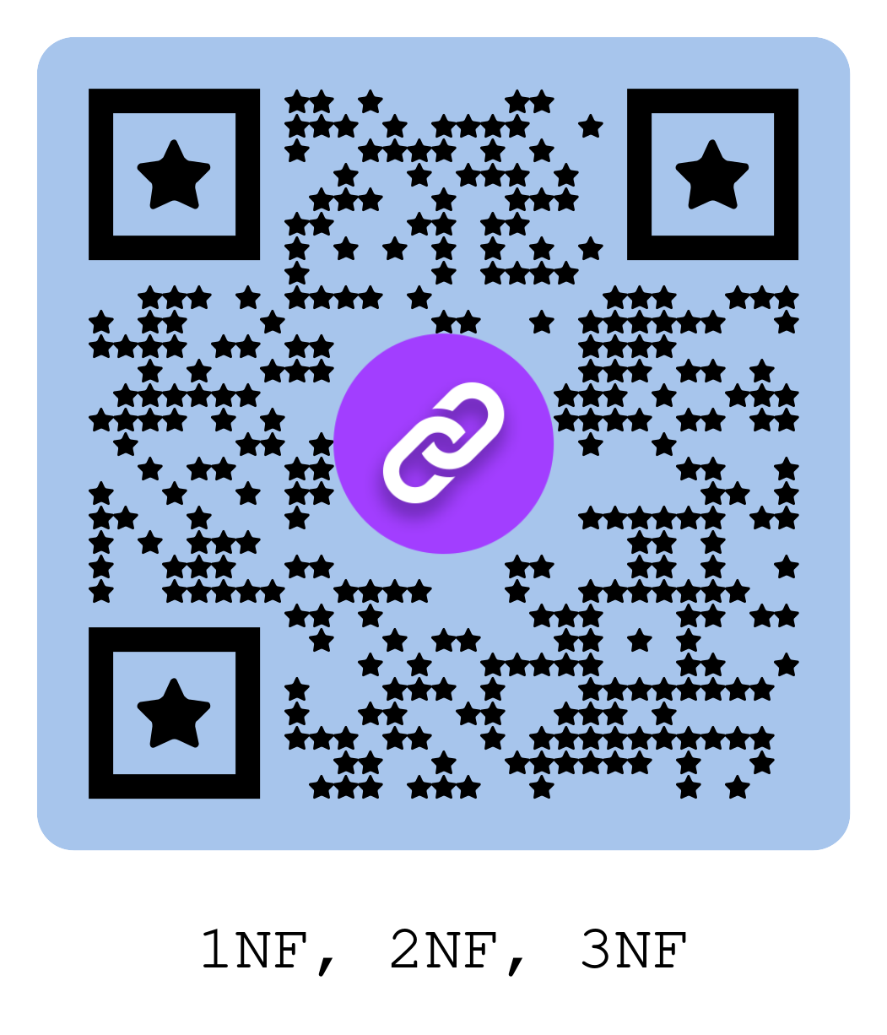
Evaluating Your Current Database
Organize a database into several tables
“Assess the structure and adherence to 3NF”
Identifying data types:
Strings, decimals, byte arrays, etc.
Evaluating data quality and composition
Considering costs and logic on-prem vs. cloud

Slide 8
Cloud Functions & SQL Integration
Using cloud functions (AWS, Azure, OIC, etc.) for custom ETL operations
Integrating cloud SQL for relational data
Use CosmosDB/ DynamoDB/ Oracle NoSQL for NoSQL, JSON, and blob storage
Importance of a planned, hard switch for cost-effectiveness
Detailed assessment of existing databases (foreign keys, data types)
Differences in handling terabytes vs. petabytes of data
DataBox fam; Snowball/Snowcone/Snowmobile/Snowbominabal Snowman
Expecting challenges with legacy databases
Perhaps you are part of a huge organization and you do multiple environments
Connect two separate regions / providers using network solutions
Azure Virtual WAN; AWS Transit Gateway; OIC FastConnect

Slide 9
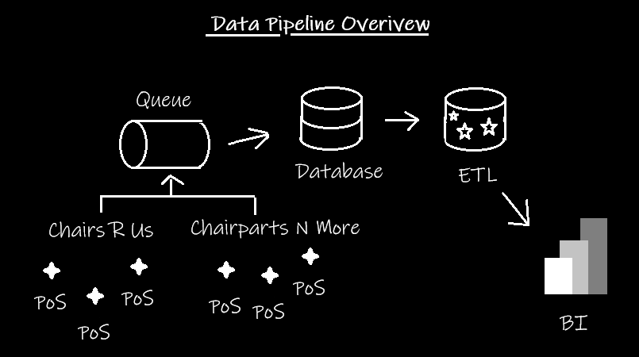
Best Practices & Real-World Examples
“What’s a practical use of a data lake?”
What’s _____ for IRL?
Hint:
“Who are you?”
“Do we have any _______?”
The solution to all of our problems…

Slide 10
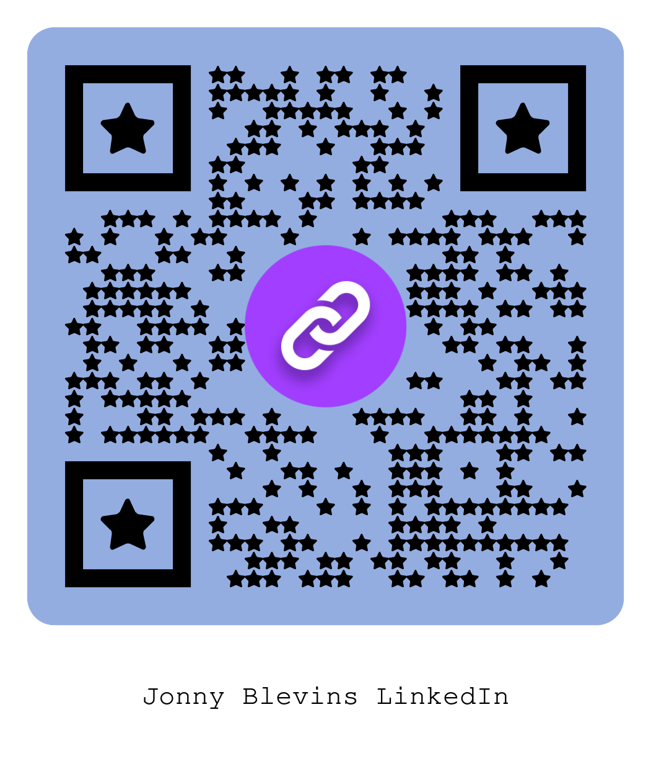
Thank you kindly. ☆

